Slide 1
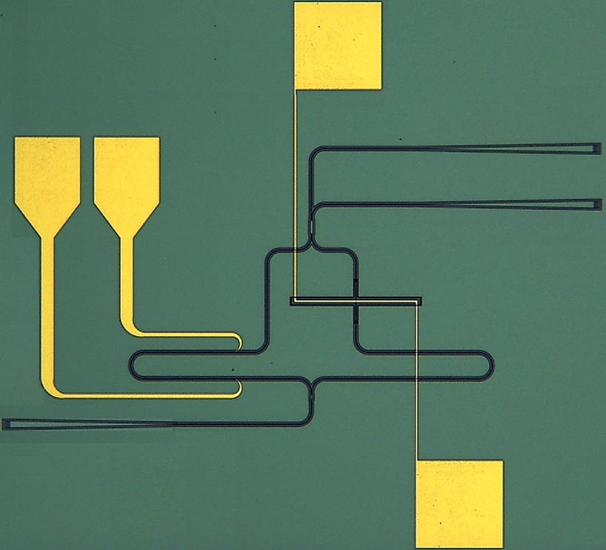
MICRO-373: TP introduction
Topic 1: Integrated photonic chip
Spring semester 2024
Micro heater
OUT
Professor:
Ileana-Cristina Benea-Chelmus
Teaching assistants:
Francesco Bertot
Jiawen Liu
Antenna
IN
23/02/2024

Slide 2


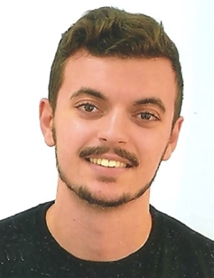
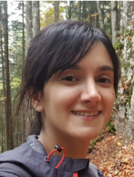
Professor and TAs
Professor: Ileana-Cristina Benea-Chelmus
TAs:
Jiawen Liu
Francesco Bertot
Zahra Basiri (backup)

Slide 3
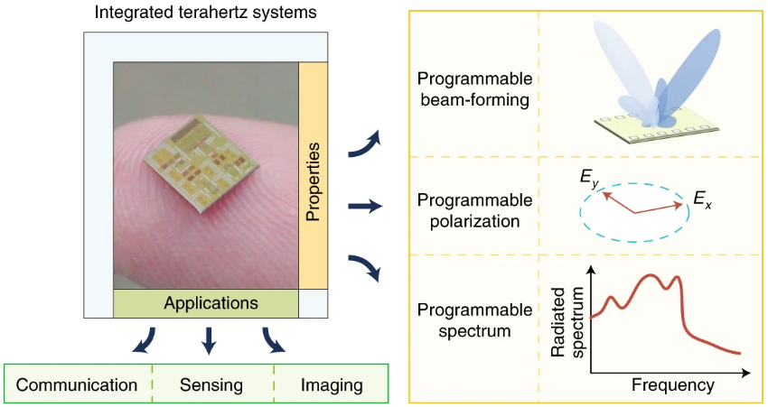
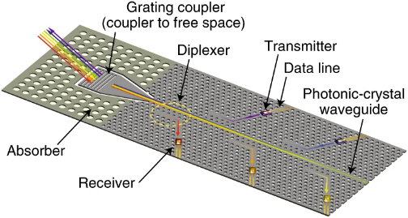
Integrated photonics: overview
Compact high-frequency components with large variety of applications
K. Sengupta, et al., Nat. Electronics 1, 622–635 (2018), https://doi.org/10.1038/s41928-018-0173-2

Slide 4
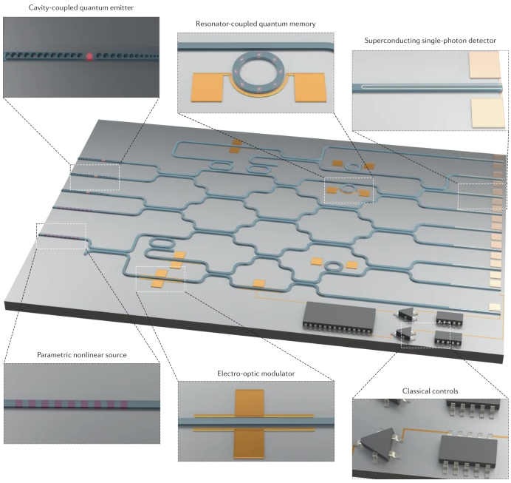
Integrated photonics: overview
Compact high-frequency components with large variety of applications
Cointegration and compatibility with multiple alternative technologies
K. Sengupta, et al., Nat. Electronics 1, 622–635 (2018), https://doi.org/10.1038/s41928-018-0173-2
E. Pelucchi, et al., Nat Rev Phys 4, 194–208 (2022). https://doi.org/10.1038/s42254-021-00398-z

Slide 5
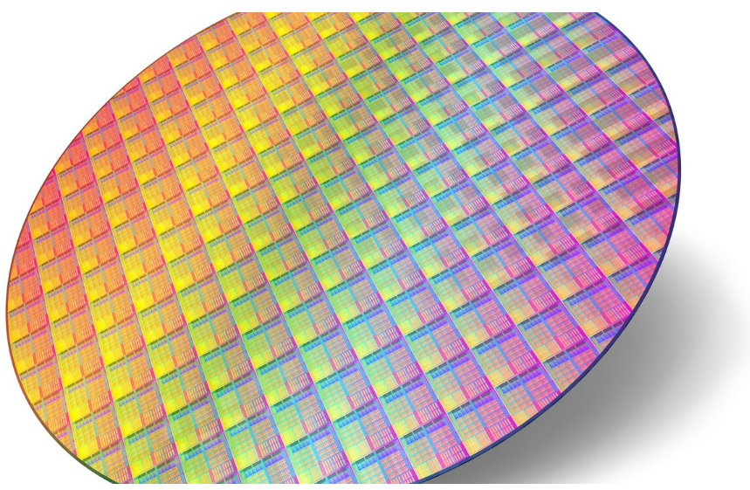
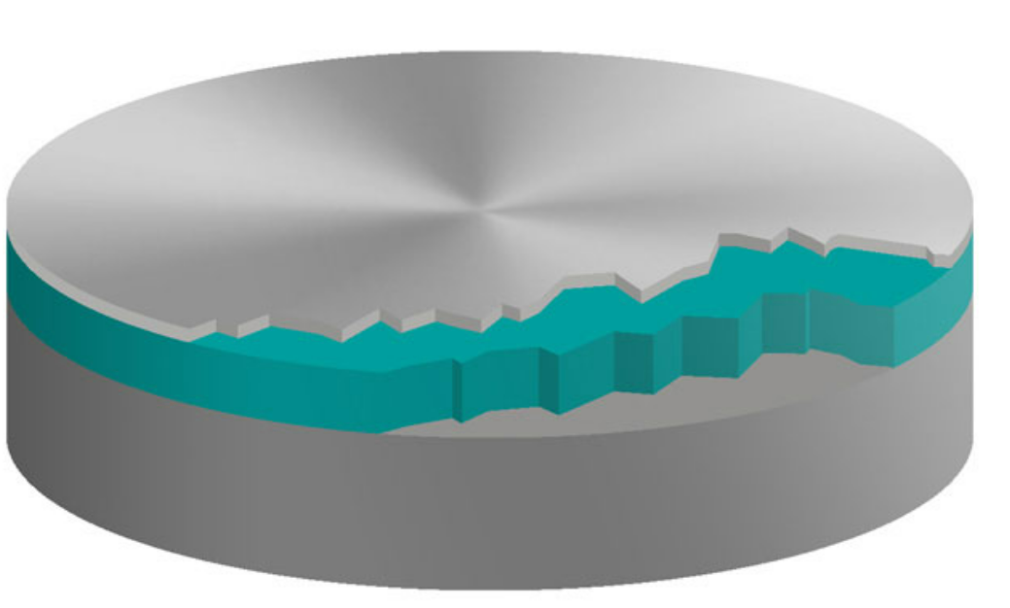
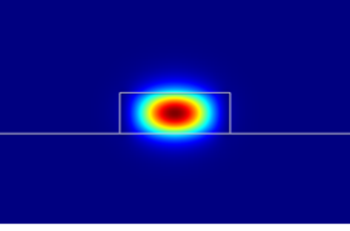
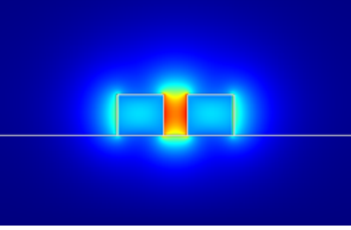
Silicon-on-insulator (SOI) integrated photonics
Buried oxide (BOX)
2 - 3 µm
Silicon-On-Insulator (SOI) platform for cutting-edge technologies
Top Si device layer
220 nm
SiO₂
High refractive index contrast: @ 1550 nm n_{Si} = 3.45, n_{SiO2} = 1.45
Silicon substrate
SOI waveguides (WG): strip and slot geometry
Optical field confinement (λ = 1550 nm)
Strip WG
Slot WG
450 nm
500 nm
Si core
Si rails
220 nm
SiO₂ cladding
SiO₂
SiO₂
https://www.computerbase.de/2021-06/rohlinge-globalfoundries-sichert-sich-soi-wafer-von-globalwafers
https://www.siegertwafer.de/SOI-Wafer.html
P. Steglich, et al., Photoptics 2015, https://doi.org/10.13140/RG.2.1.1147.8565

Slide 6
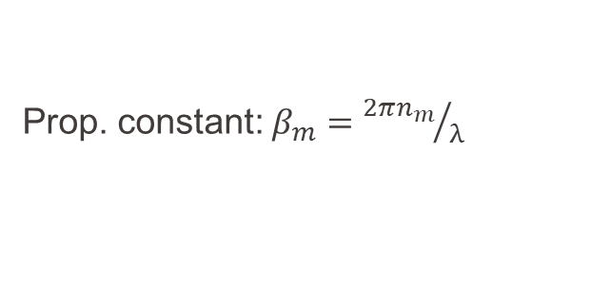
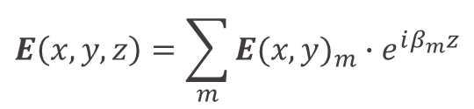
SOI waveguides and components
Field confinement and discretization into modes:
$$E\left(x,y,z\right)=\sum_{m}{{E(x,y)}_{m}∙e^{iβ_{m}z}}$$
y
Fixed distribution in (x,y) plane
Propagation along z
Si
Prop. constant: $β_{m}={2πn_{m}}/λ$
x
SiO₂
Main parameter is $n_{m}$, defined by geometry, tunable (in our case) using micro-heaters

Slide 7
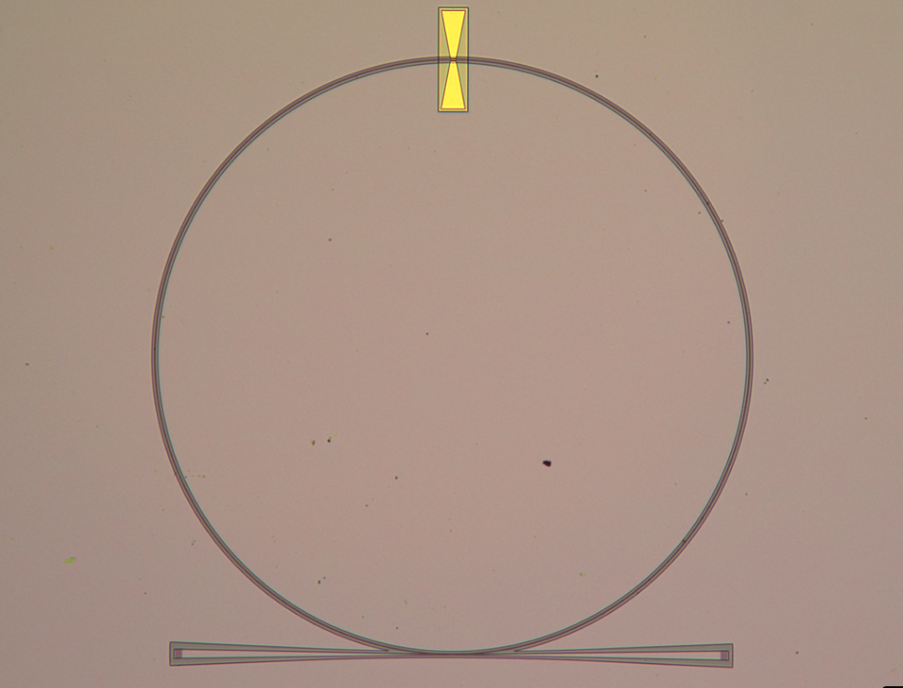
SOI waveguides and components
Field confinement and discretization into modes:
$$E\left(x,y,z\right)=\sum_{m}{{E(x,y)}_{m}∙e^{iβ_{m}z}}$$
y
Fixed distribution in (x,y) plane
Propagation along z
Si
Prop. constant: $β_{m}={2πn_{m}}/λ$
x
SiO₂
Main parameter is $n_{m}$, defined by geometry, tunable (in our case) using micro-heaters
Multi-Mode interferometers (MMI)
Mach-Zehnders interferometers (MZI)
Couplers and ring resonators
Au antenna
Si
100 μm
100 μm
SiO2
Grating coupler
X-coupler
10 μm

Slide 8
SOI waveguides and components
Field confinement and discretization into modes:
$$E\left(x,y,z\right)=\sum_{m}{{E(x,y)}_{m}∙e^{iβ_{m}z}}$$
y
Fixed distribution in (x,y) plane
Propagation along z
Si
Prop. constant: $β_{m}={2πn_{m}}/λ$
x
SiO₂
Main parameter is $n_{m}$, defined by geometry, tunable (in our case) using micro-heaters
Multi-Mode interferometers (MMI)
Mach-Zehnders interferometers (MZI)
Couplers and ring resonators
Au antenna
100 μm
SiO2
Si
100 μm
Si
SiO2
Grating coupler
X-coupler
200 nm
10 μm

Slide 9
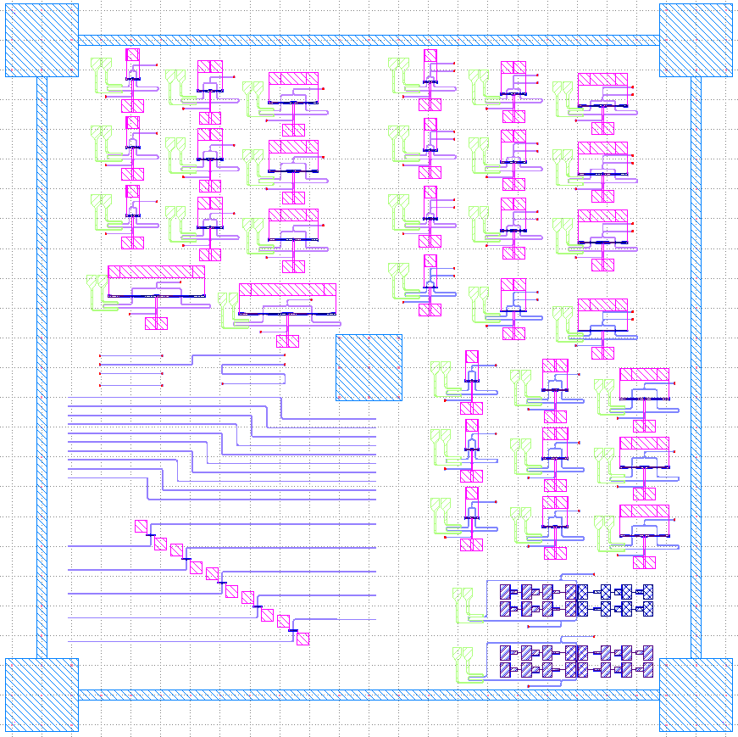
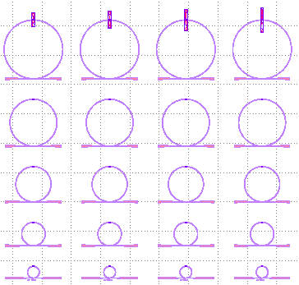
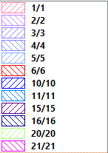
Complete GDS design example
Every layer is a lithography step!
1 mm

Slide 10
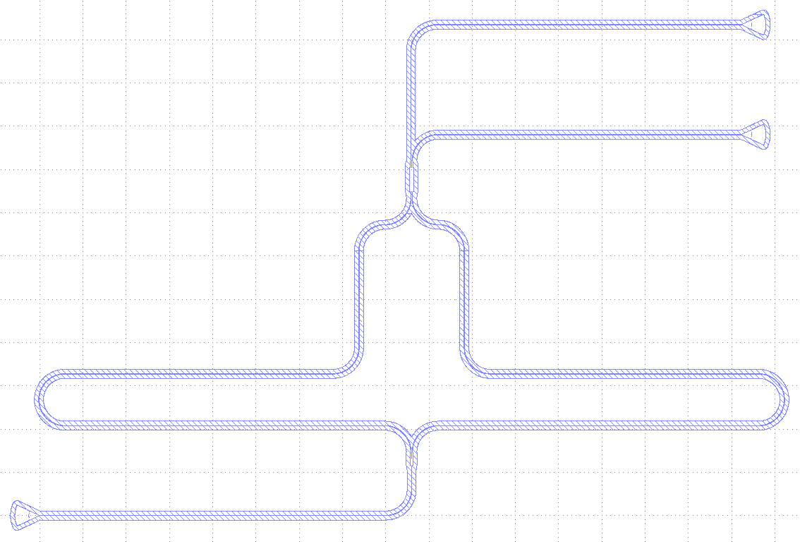
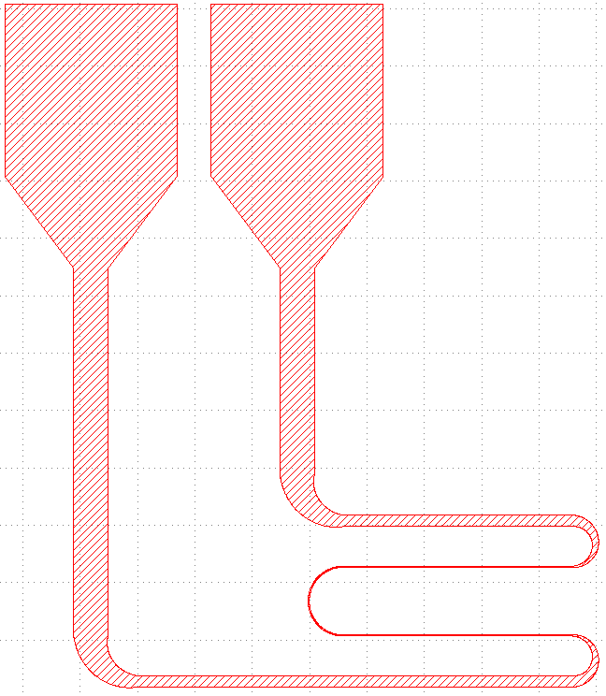
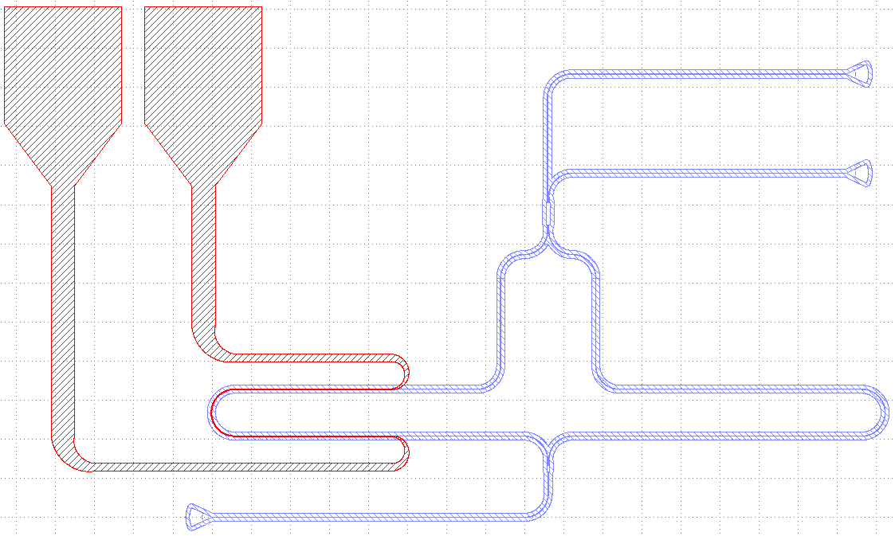
What we will create together
Layer 1: waveguides
Layer 2: heaters
Final result:
Requires precise alignment

Slide 11
Fabrication process flow
Si
ZEP
220 nm
SiO2
2 μm
1. Starting point: SOI wafer
725 μm
2. First E-beam lithography for waveguides
ZEP resist spin coating, exposure and development
3. Si dry etching and resist stripping
Si
Si
Si
SiO2
Y-splitter
SiO2
SiO2
2 μm
200 nm
200 nm

Slide 12
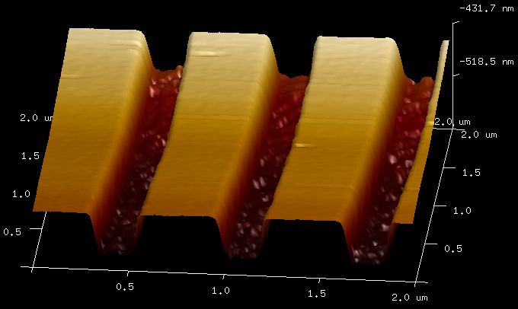
Fabrication process flow
Si
ZEP
220 nm
SiO2
2 μm
1. Starting point: SOI wafer
725 μm
2. First E-beam lithography for waveguides
ZEP resist spin coating, exposure and development
3. Si dry etching and resist stripping
Grating coupler
Atomic Force Microscope
Si
Si
SiO2
Si
200 nm
SiO2
3 μm
3.5. Additional Si shallow etch (only 70 nm) performed by TAs

Slide 13
Fabrication process flow
Si
ZEP
PMMA
Au
220 nm
SiO2
MMA
Ti
2 μm
1. Starting point: SOI wafer
725 μm
2. First E-beam lithography for waveguides
ZEP resist spin coating, exposure and development
3. Si dry etching and resist stripping
4. SiO2 cladding PECVD
5. Second E-beam lithography for heaters
MMA/PMMA resist double layer spin coating, exposure and development
10 μm
6. Heaters (Ti-Au) deposition and lift-off

Slide 14
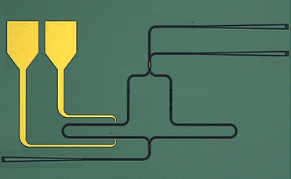
Fabrication process flow: final results
Heater
Au
SiO2
X-coupler
MZI
y-splitter
100 μm
Au
Au
SiO2
500 nm
SiO2
500 nm

Slide 15
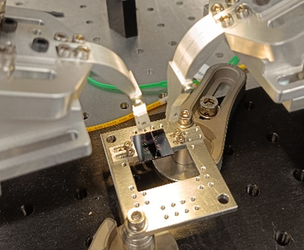
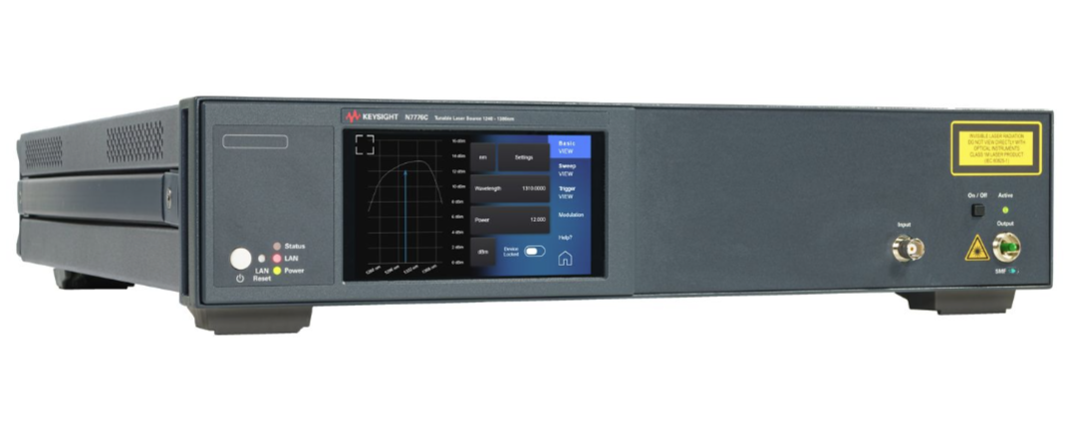
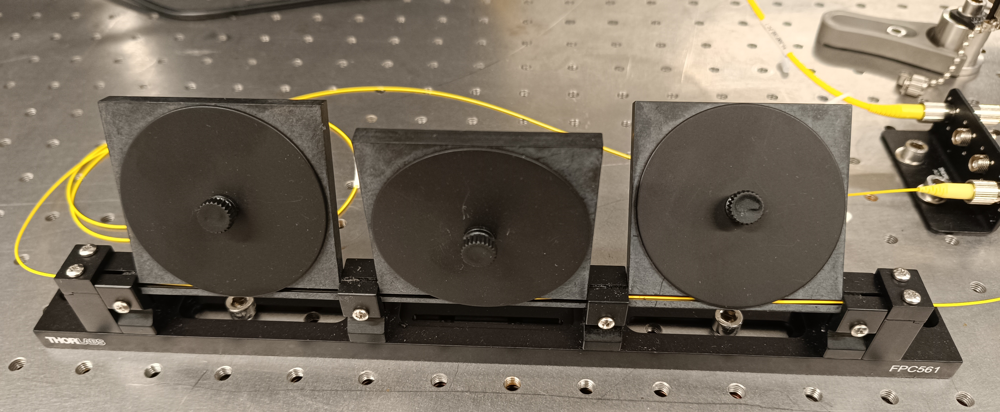
Characterization: setup in HYLAB laboratories
Characterization of the waveguides in transmission:
TLS
PMF
PC
OF
OF
PM
Acronims:
TLS = Tunable Laser Source
PMF = Polarization maintaining fiber
PC = Polarization controller
OF = Optical fiber
PM = Power Meter

Slide 16
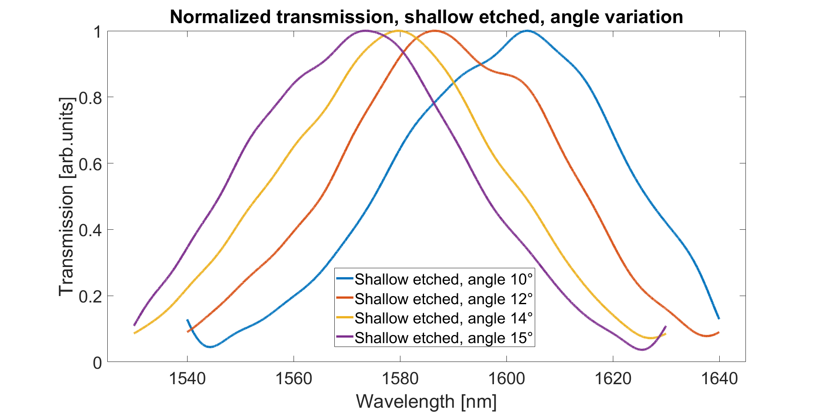
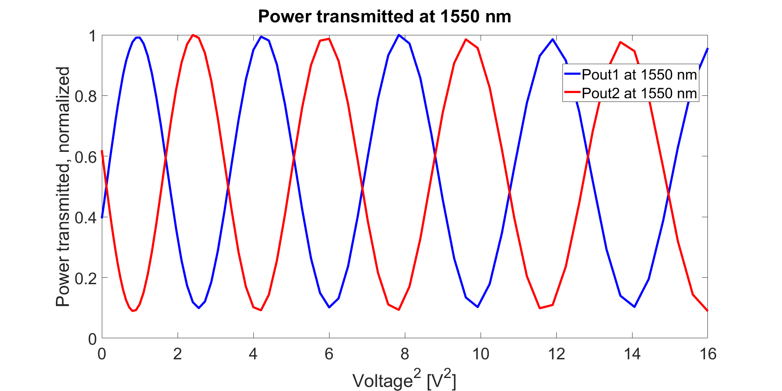
Typical transmission spectra
Simple waveguide:
Ang
50 nm
Si
SiO2
MZM with heater tuning n_{m}:
Out 1
V+
V-
Out 2
In

Slide 17
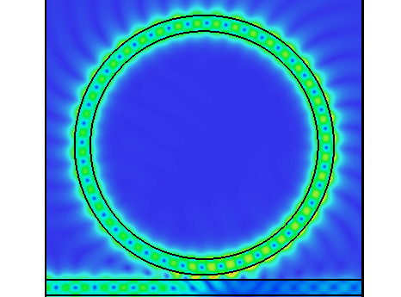
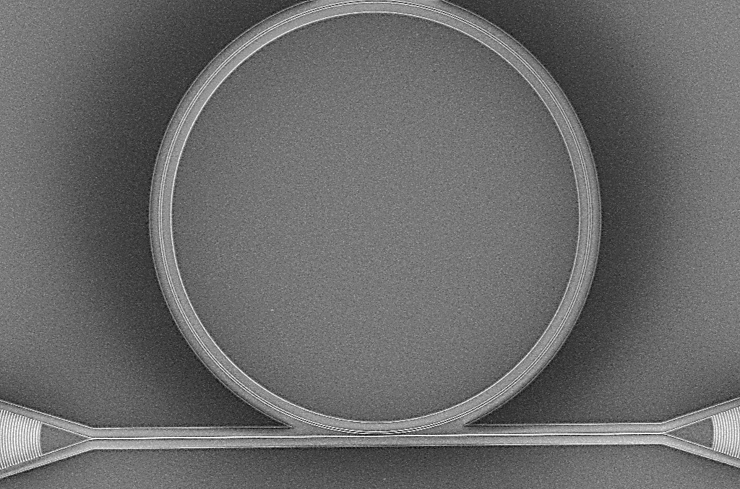
Typical transmission spectra
Ring resonators:
CST simulation
SEM image
10 µm
Transmission measurements
dB
Radius=100 µm
Radius=200 µm
Wavelength (nm)

Slide 18
Organization of the semester
Week | Date | Step
1 | 01 – Mar | Theory/simulation + start GDS
2 | 08 – Mar | GDS creation
3 | 15 – Mar (CMi 1) | E-beam litho for waveguides
4 | 22 – Mar (Cmi 2) | Si dry etching + resist strip
5 | 12 – Apr (Cmi 3) | SEM + AFM
6 | 19 – Apr (Cmi 4) | E-beam litho for heaters
7 | 26 – Apr (Cmi 5) | Heaters deposition and lift-off
8 | 03 – May (Cmi 6) | SEM + Reflectometry
9 | 10 – May | Transmission measurements
10 | 17 – May | Transmission measurements
11 | 24 – May | Data analysis + report
12 | 31 – May | Report + final presentation prep
Sessions on Friday 14h15 to 18h
More details on the process flow and the tools used in cleanroom on Moodle
Transmission measurements in HYLAB laboratories, BM3237 and BM3239
Report submission due on June 7th, one week after the last session: follow guidelines on Moodle

Slide 19
Preparation for first session
For mask layout visualization: download K-layout from https://www.klayout.de/build.html selecting the most recent version
Try to open the GDS example found on Moodle and play with layers and components
For mask layout creation: we will use Python packages, so be ready to work on the Python environment you prefer.
Our main choice is Spyder, launched through Anaconda. In this case, you can download it from www.anaconda.com
A potential alternative is Jupyter Notebook, always launched through Anaconda
Prepare any question you want to ask to us!

Slide 20
MICRO-373: TP introduction
Topic 1: Integrated photonic chip
Spring semester 2024
Micro heater
OUT
Professor:
Ileana-Cristina Benea-Chelmus
Teaching assistants:
Francesco Bertot
Jiawen Liu
X-coupler
IN
23/02/2024

